Slide 1
Some Major types of leadership theories
Charismatic Leadership Theory
Contingency Leadership Theory
Behavioral Leadership Theory
Trait Leadership Theory

Slide 2
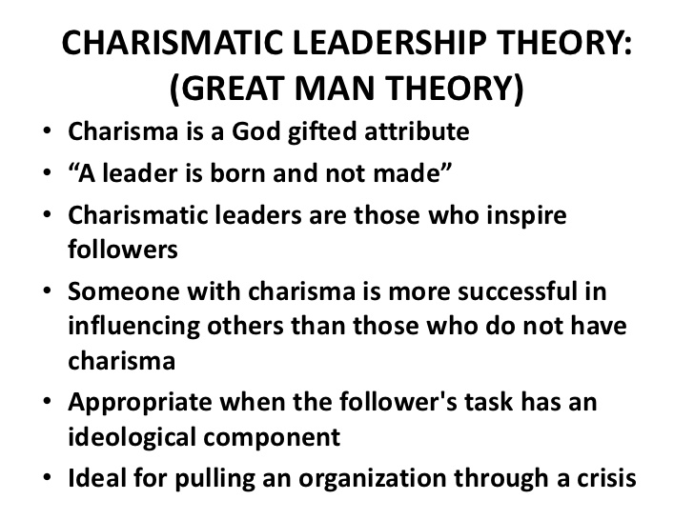

Slide 3
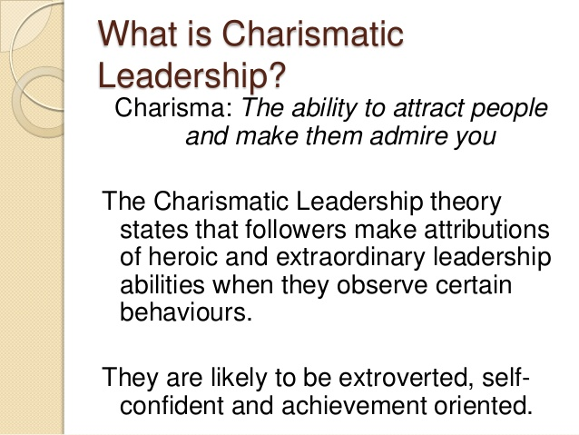

Slide 4
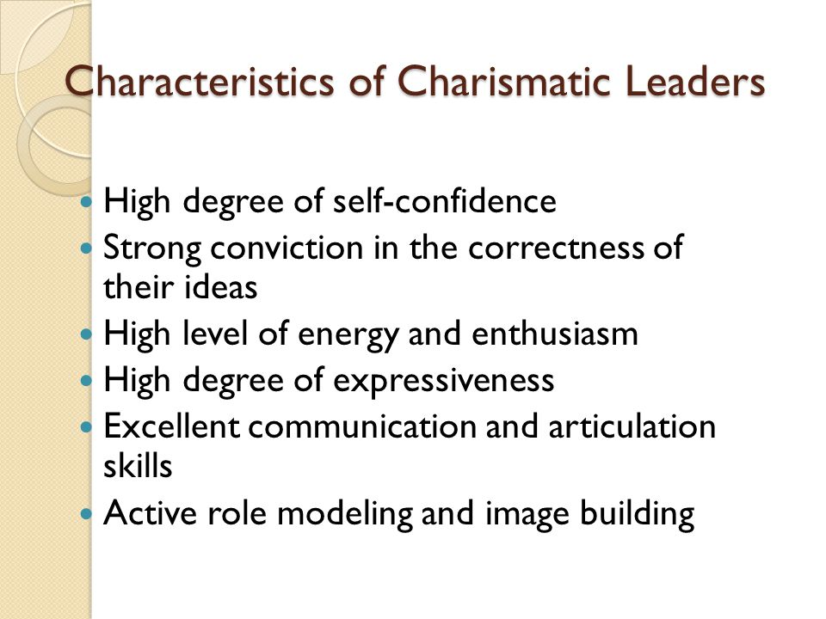

Slide 5
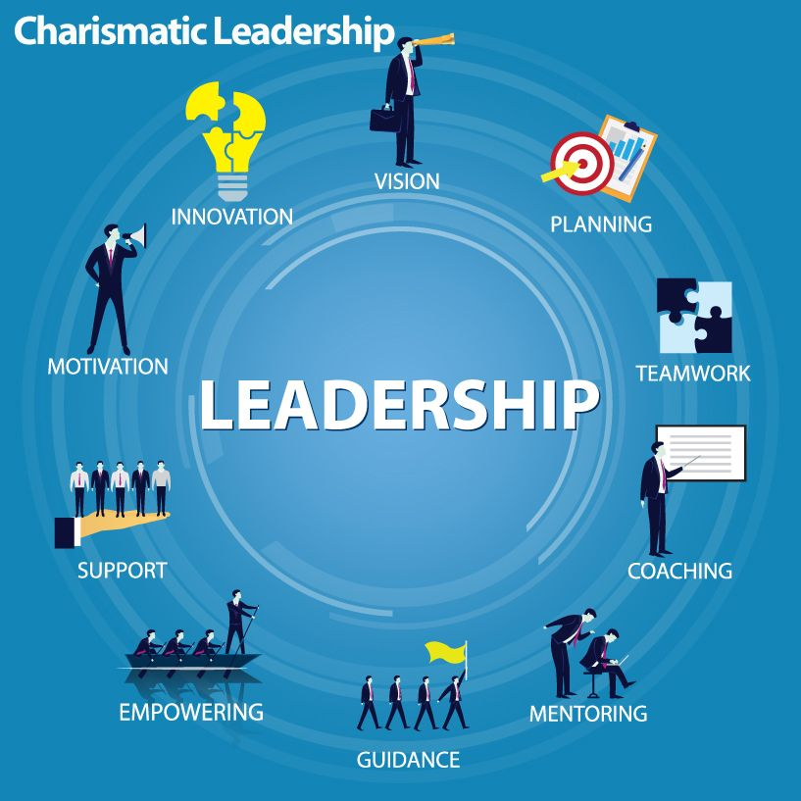

Slide 6
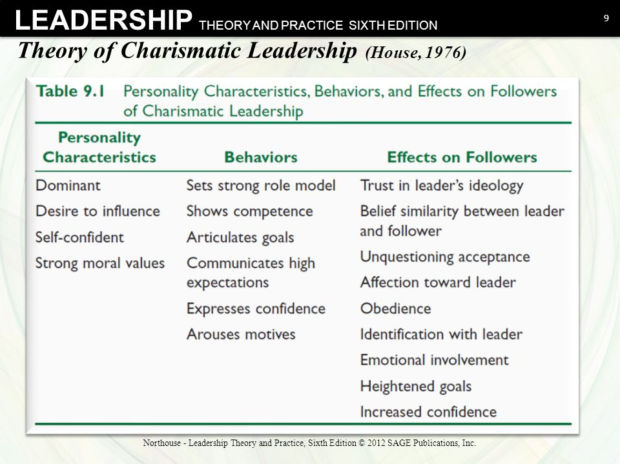

Slide 7
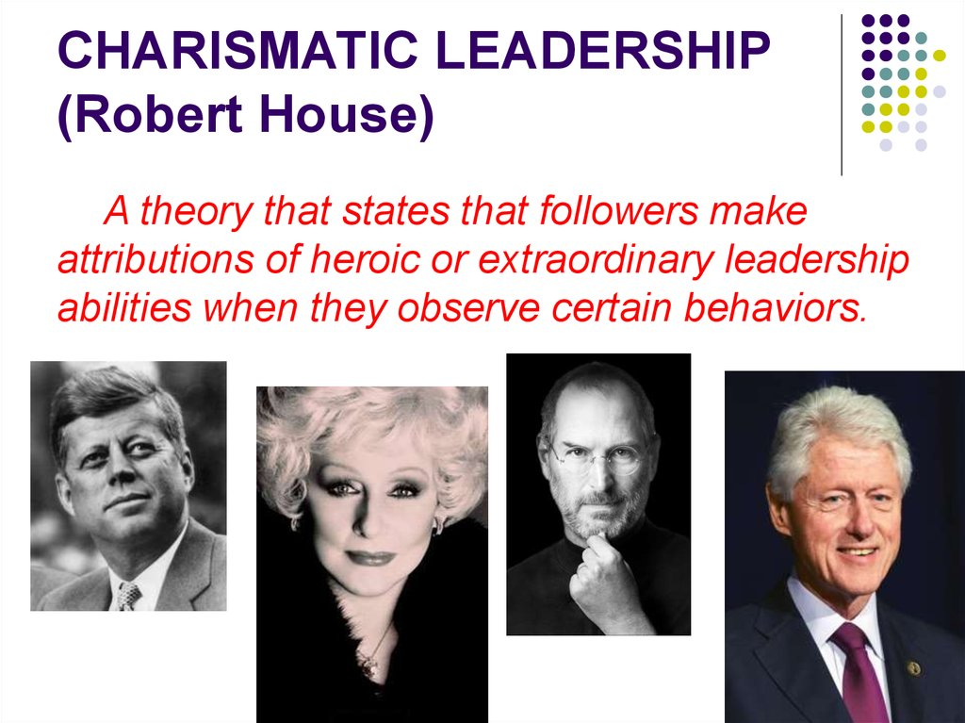

Slide 8
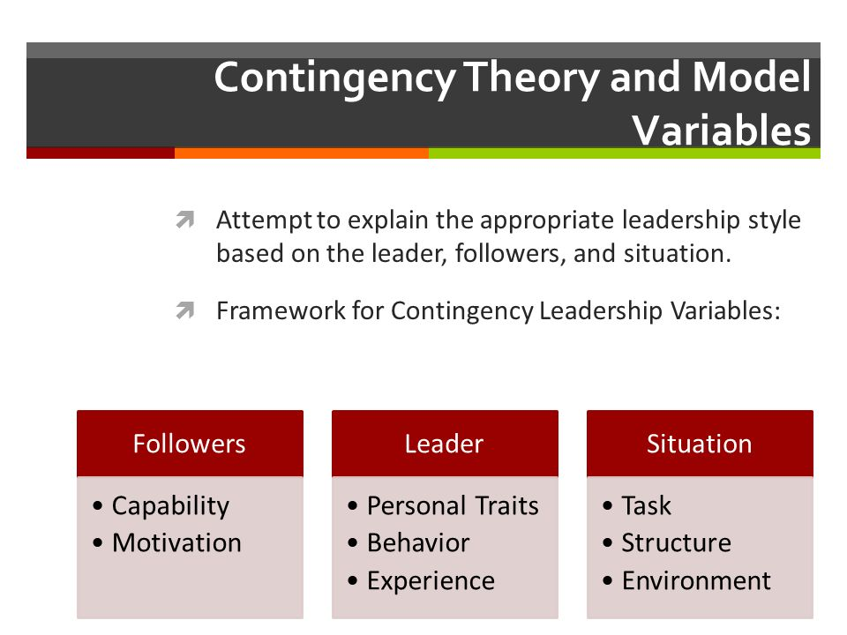
Contingency Leadership Theory

Slide 9
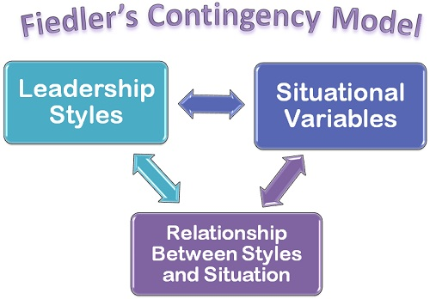

Slide 10
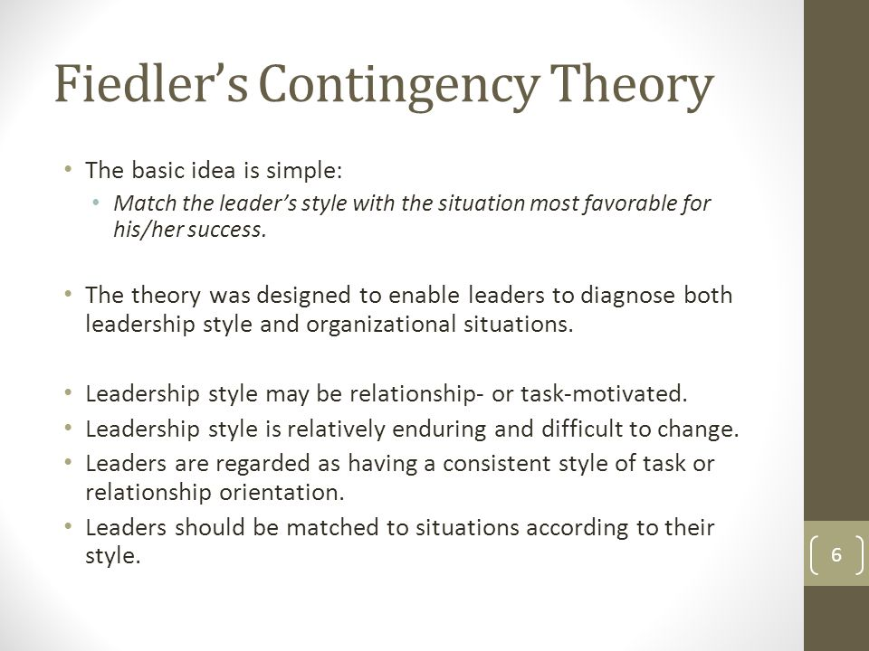

Slide 11
Contingency Theory of Leadership
The Contingency Theory of Leadership states that a leader's effectiveness is contingent upon with how his or her leadership style matches to the situation. That is, the leader must find out what kind of leadership style and situation he or she thrives in.
Contingency Theories include: 1. Fiedler's Contingency Theory, 2. the Situational Leadership Theory, 3. the Path-Goal Theory and 4. the Decision-Making Theory.
The basic premise of Contingency Theory is that there is no one best way to lead an organization. Fred Fiedler is a theorist whose Contingency Trait Theory was the precursor to his Contingency Management Theory. Fiedler believed there was a direct correlation to the traits of a leader and the effectiveness of a leader.

Slide 12
The Path-goal Contingency Theory
The Path-Goal model is a theory based on specifying a leader's style or behavior that best fits the employee and work environment in order to achieve a goal (House, Mitchell, 1974). The goal is to increase your employees' motivation, empowerment, and satisfaction so they become productive members of the organization.
According to it, the main principle is the leadership role, who analyzes and sets goals with the team, assistance is provided to find the best path to achieve the goals and also helps subordinates in providing solutions to the difficulties coming in the way.
The original Path-Goal theory identifies achievement-oriented, directive, participative, and supportive leader behaviors rooted in four (4 styles). The Four Styles: ... This behavior is predominant when employees are highly personally involved in their work.

Slide 13
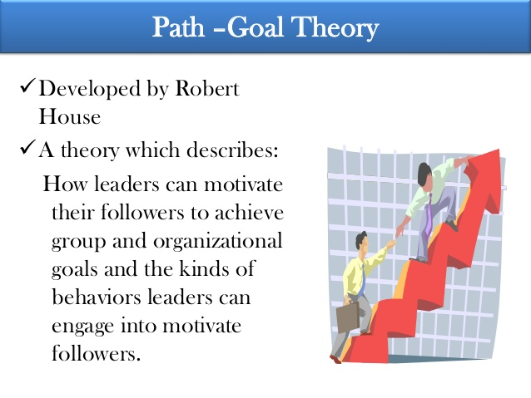
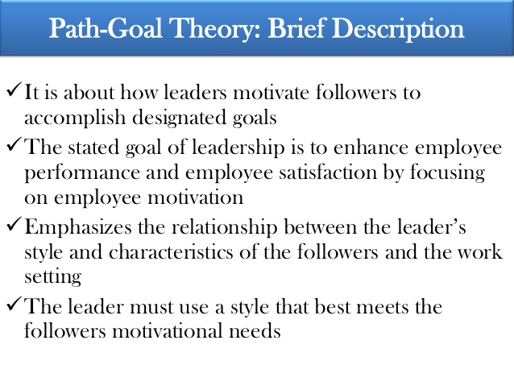

Slide 14
Contingency Leadership Model of Decision making
Many contingency theories define leadership effectiveness in terms of group performance or team satisfaction.
However, the normative decision model is a unique contingency theory in its exclusive focus on providing prescriptions to optimize the leader's decision-making process.
The normative decision model, originally developed by Victor Vroom and Phillip Yetton in 1973 and later revised by Victor Vroom and Arthur Jago, emphasizes situational factors more than leadership behaviors.
It outlines a set of five different decision-making strategies that range on a continuum from directive to participative decision making.
These strategies include two types of autocratic styles (the leader decides alone), two types of consultative styles (the leader consults followers but decides alone), and a group decision-making option (group consensus)

Slide 15
Contingency Leadership Theory of Decision Making Contd.
When applied to decision-making, the effectiveness of the decision in question depends on a balance of how important the decision is, how complete the decision maker's and the subordinates' information is on the subject, and the likelihood of acceptance of the decision by subordinates.
Changing the nature of any one factor alters the relationship with the other two. This may require the small business owner to share more information about an unpopular decision to increase the chances her staff will accept the changes.

Slide 16
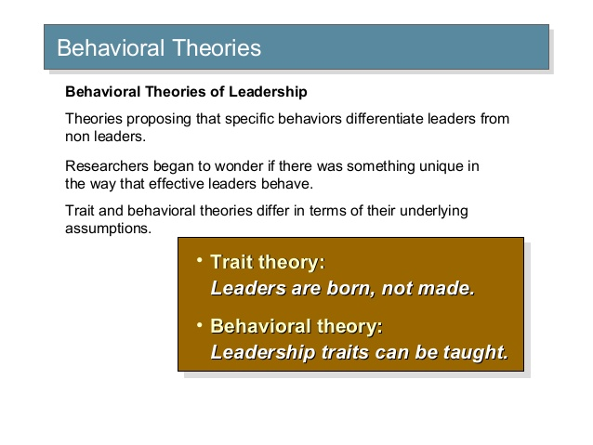
Behavioral Leadership Theory
Behavioral Theory of Leadership is a leadership theory that considers the observable actions and reactions of leaders and followers in a given situation. ...
Behavioral theories of leadership are classified as such because they focus on the study of specific behaviors of a leader.
House and Mitchell (1974) defined four types of leader behaviors or styles:
Directive,
Supportive,
Participative, and
Achievement

Slide 17
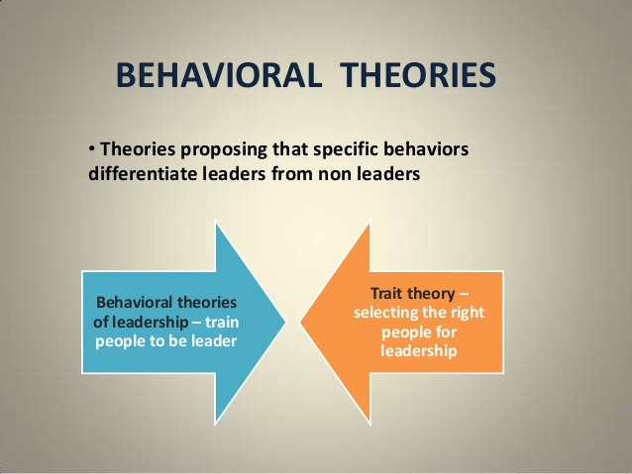

Slide 18
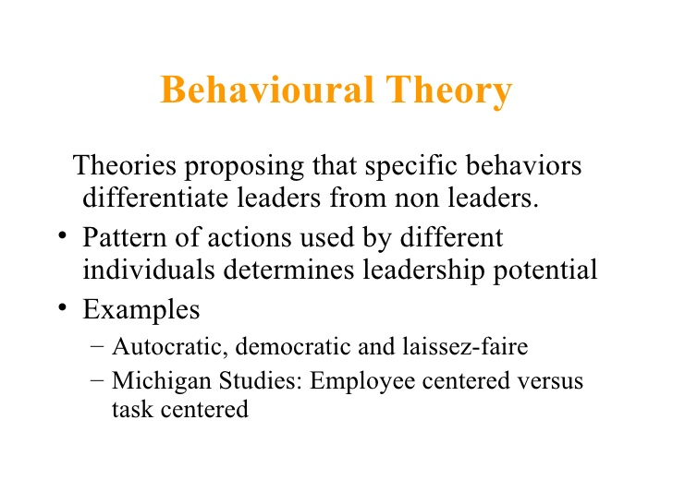
The Michigan Leadership Studies were the well-known series of leadership studies that commenced at the University of Michigan in the 1950s by Rensis Likert, with the objective of identifying the principles and types of leadership styles that led to greater productivity and enhanced job satisfaction among workers.
The studies identified two broad leadership styles – an employee orientation and a production orientation. They also identified three critical characteristics of effective leaders – task-oriented behavior, relationship-oriented behavior and participative leadership.The studies concluded that an employee orientation rather than a production orientation, coupled with general instead of close supervision, led to better results. The Michigan leadership studies, along with the Ohio State University studies that took place in the 1940s, are two of the best-known behavioral leadership studies and continue to be cited to this day.

Slide 19
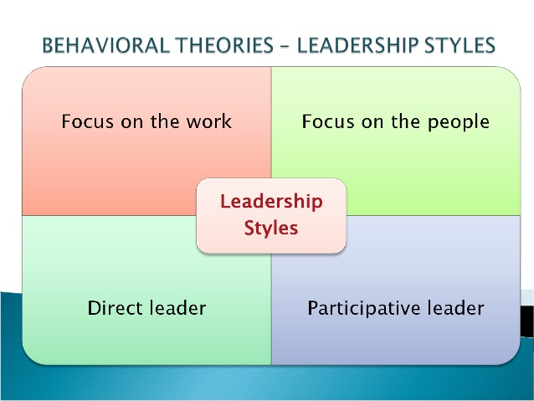

Slide 20
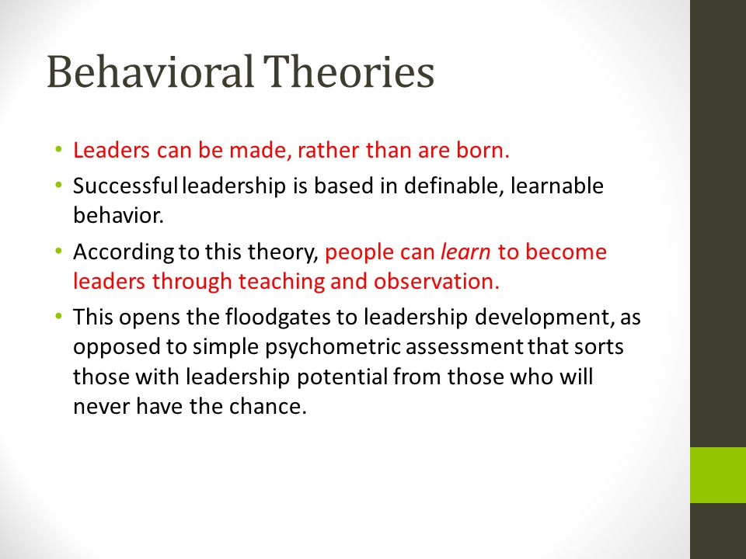

Slide 21
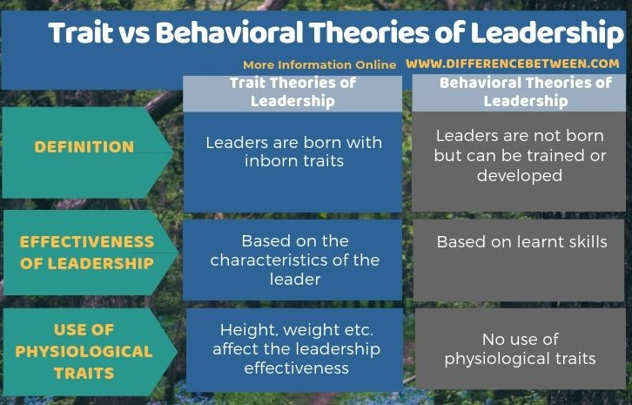

Slide 22
Trait Theory of Leadership
The trait theory of leadership is an early assumption that leaders are born and due to this belief, those that possess the correct qualities and traits are better suited to leadership. ...
The resulting lists of traits are then compared to those of potential leaders to assess their likelihood of success or failure.
His ability to passionately articulate his visions made people want to follow is lead.
Some other examples of traits that make an effective leader include intelligence, self-confidence, integrity and
determination.
one of the oldest methods of increasing the effectiveness of leadership and is based on the “great man theory of leadership" that was first introduced by Thomas Carlyle in the 19th century. The theory is based on the idea that certain natural abilities can help someone become a leader more easily.
The trait approach to leadership concentrates on the idea that great leaders are born with the given abilities, and not a learned ability. Individuals are brought into this world with all of the characteristics needed to become a great leader.

Slide 23
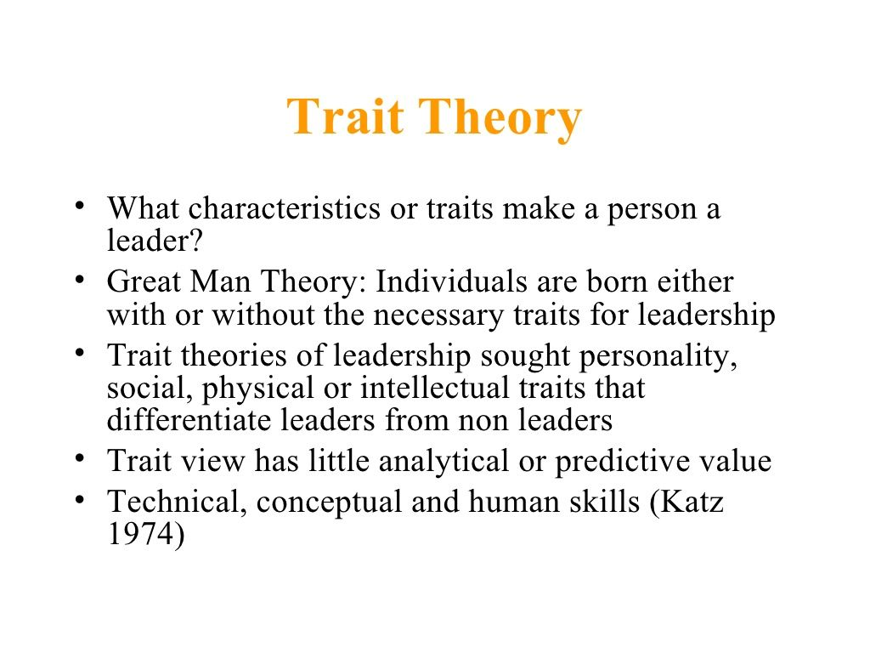

Slide 24
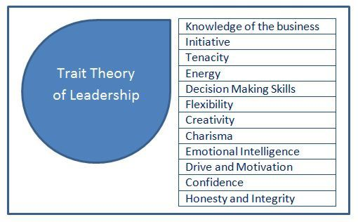
Trait Theory of Leadership: Leaders have different traits

Slide 25
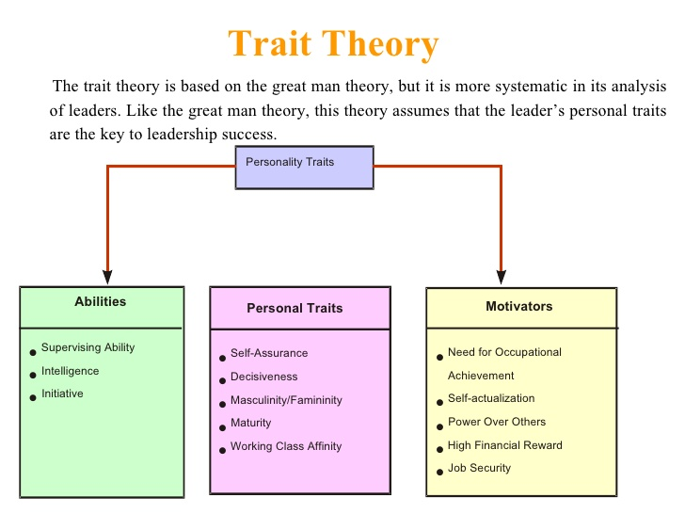

Slide 26
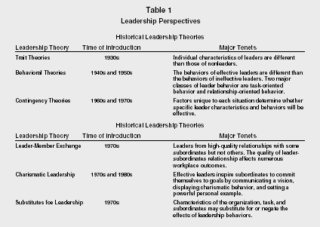

Slide 27
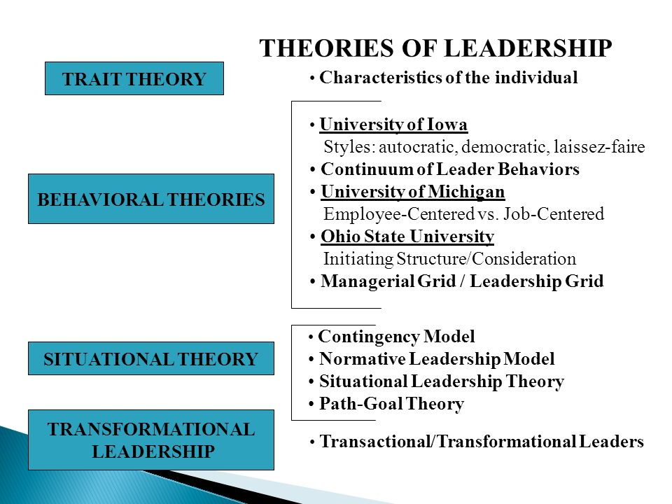
Synopsis of Leadership Theories

Slide 28
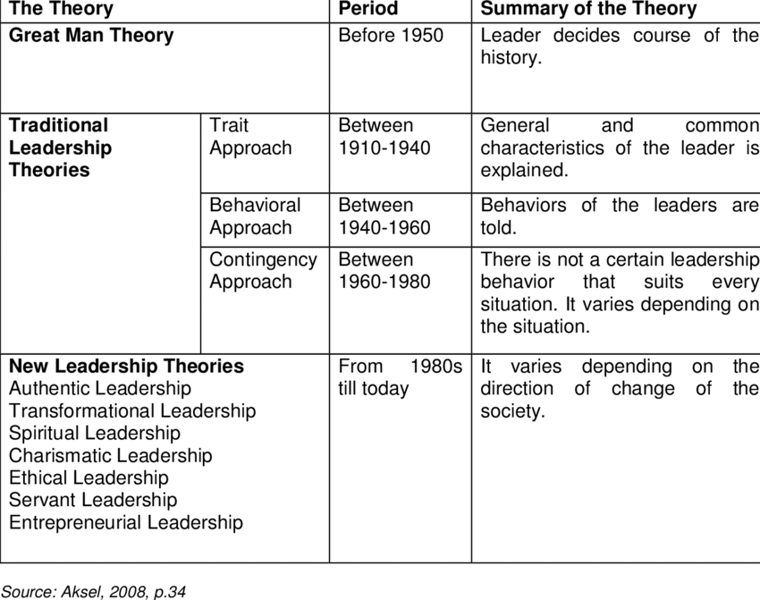

Slide 29
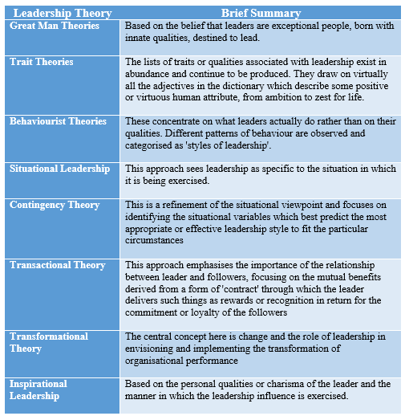

Slide 30
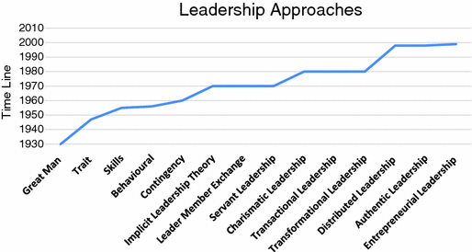

Slide 31
Discussion on Leadership Theories
Where do you find yourself very near to these different models or theories ?How and Why?

